Slide 1

Analysis on prices of cars
Exploratory Data Analysis -
(Aspiring Mind Employment Outcome (AMEO) Dataset )
by Cherukupalli.Indhu

Slide 2

About me:
I hold both a Bachelor of Science and a Master of Science degree.
To improve further in Statistics and to apply the methods of Statistics.
My academic journey has equipped me with a robust foundation in quantitative analysis, problem-solving, and critical thinking skills.
Throughout my studies, I specialized in Statistics , gaining expertise in Decision - Making.
I Interested in Analysis field.
Has of know I did not have any experience.
My career aspiration is to become a Data Scientist.
I aim to leverage my academic background and technical skills to extract actionable insights from complex datasets.
As a data scientist, I am eager to tackle real-world challenges, develop innovative solutions, and contribute to data-driven decision-making processes.
I am excited about the opportunity to apply advanced analytical techniques and machine learning algorithms to solve diverse problems and drive business value.

Slide 3
Agenda :
Objective : To explore the AMEO dataset to understand how different factors affect people's careers, helping organizations make better decisions.
Raw Data : Checking whether the data is cleaned or Not.
Data Cleaning : I Perform Numpy and Pandas Operations for ( Data Preprocessing ) converting Raw Data to Cleaned Data.
Data Manipulation : It Involves the process of transforming and modifying raw data to make it suitable for analysis.
Data Analysis : I used Groupby , Crosstab for Data Analysis to draw more insights from Data.
In Data Analysis , I perform Univariate , Bivariate and Multivariate analysis on Cleaned Data Set.
Data Visualization : For Visualizing data , I used Matplotlib and Seaborn Libraries.
Based Upon above Steps , I conclude the Given AMEO DataSet.

Slide 4
Data Summary :
The above The dataset contains information about individuals, focusing on attributes related to their education, skills, and career outcomes.
Key attributes include unique identifiers for individuals and colleges, salary, dates of joining and leaving organizations, job designation, city of employment, gender, date of birth, education details such as grades and board, college GPA, specialization, graduation year, test scores in English, Logical, and Quantitative sections, domain knowledge score, scores in various engineering subjects, and personality traits.
Overall, the dataset provides a comprehensive view of individuals' educational backgrounds, skill sets, and career trajectories, making it suitable for exploratory analysis and modeling tasks related to talent acquisition, workforce planning, and career development.
The dataset focuses on capturing information about individuals' educational backgrounds, skills, and career trajectories. It provides insights into factors influencing career outcomes, talent acquisition, and workforce planning.

Slide 5
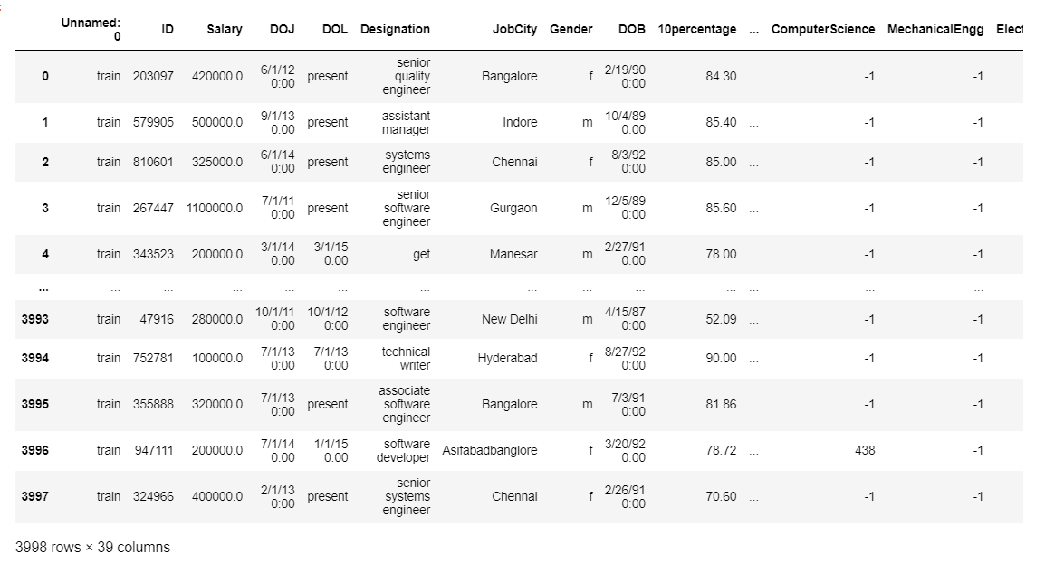
Raw Data Set:
Using NumPy and Pandas, such as handling missing values, duplicates, outliers, converting data types, standardizing data, dropping unnecessary columns, renaming columns, and saving the cleaned dataset.
Explore the dataset to understand its structure, distributions, and relationships between variables. This may involve visualizations such as histograms, scatter plots, and correlation matrices.

Slide 6
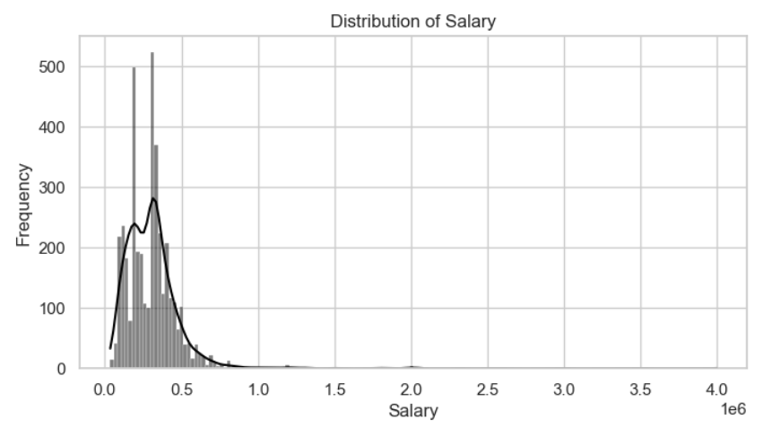
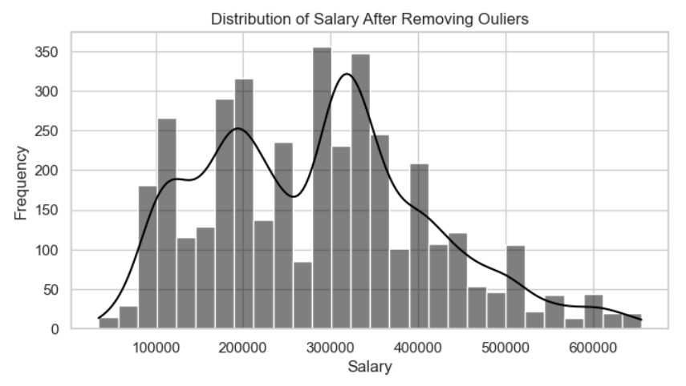
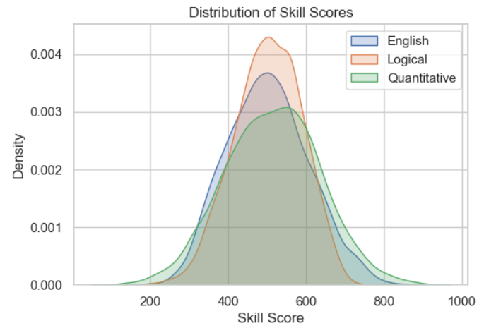
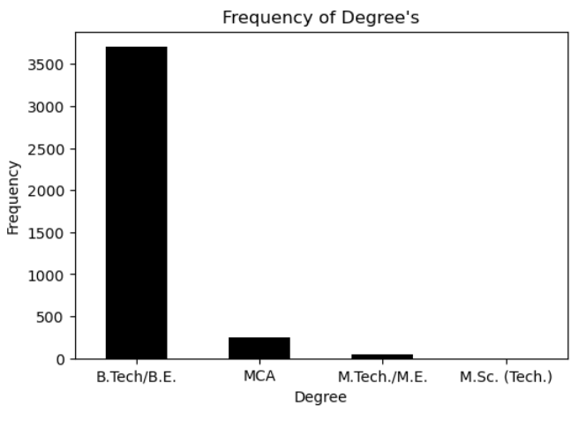
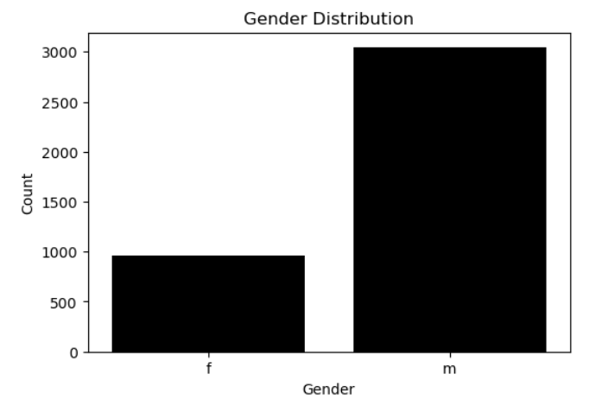
Data Visualization :
Univariate Analysis :

Slide 7
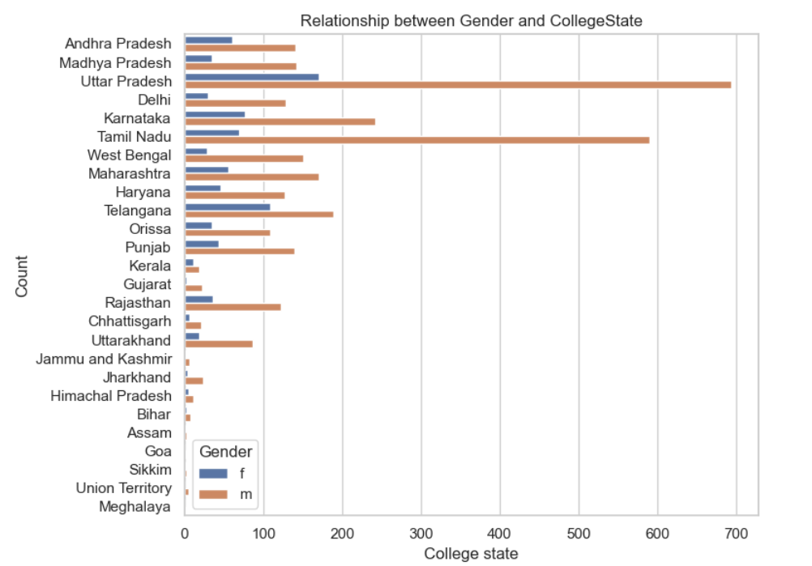
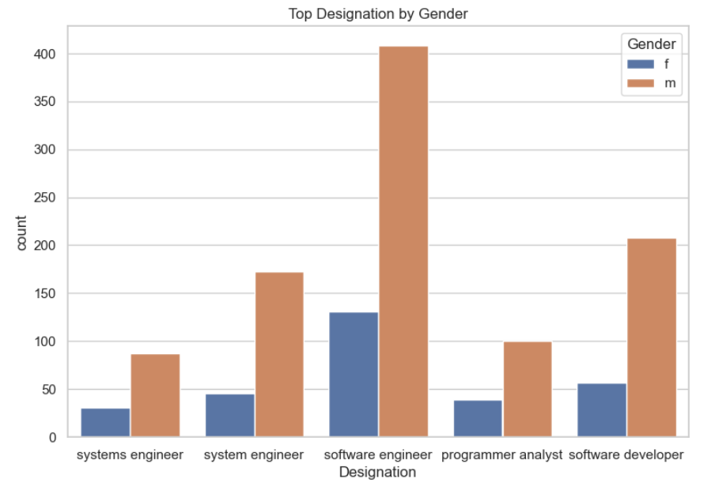
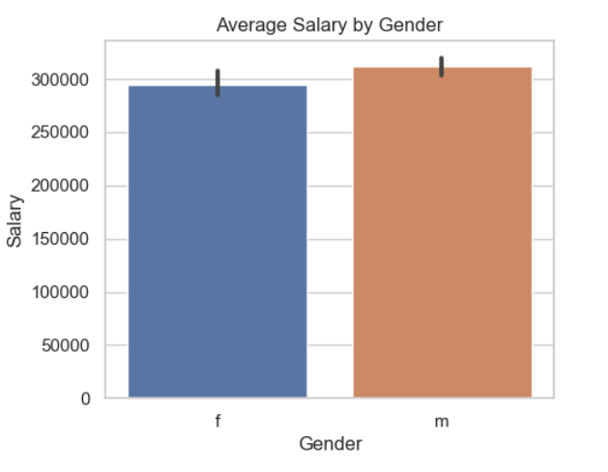
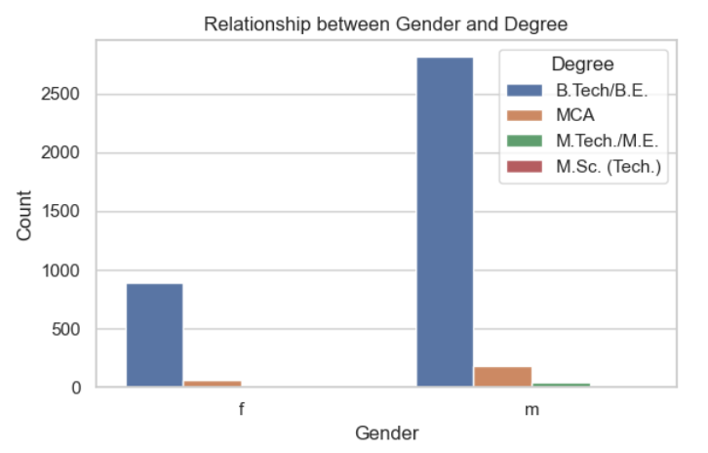
Bi- Variate Analysis :

Slide 8
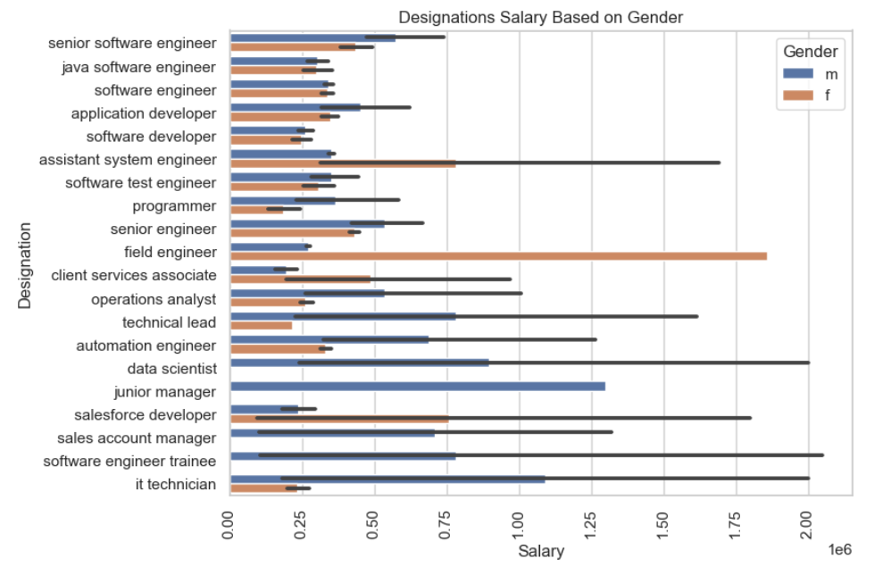
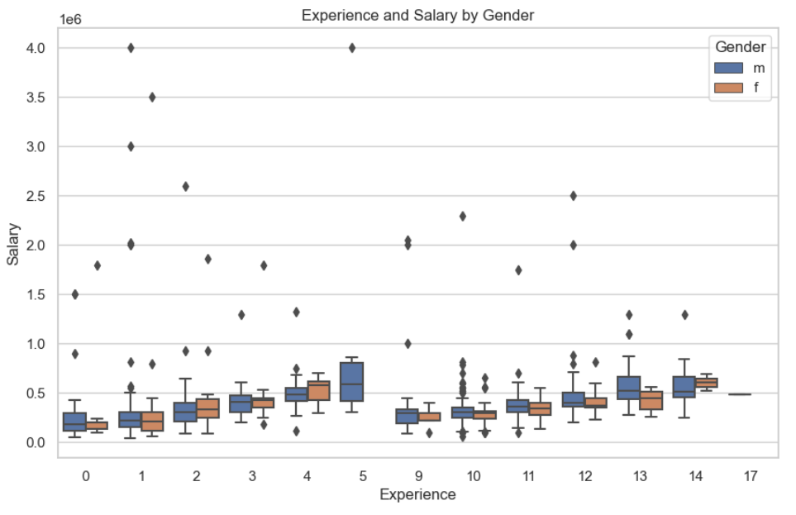
Multivariate Analysis:

Slide 9
Conclusion :
The Salary Ranges from from 35,000 to 4,000,000 with average approximately 307,700.
There are two unique Genders Male and Female.
The Majority of Gender is Male with 76% and Female is 24% approximately.
There are 4 Unique Degrees, ‘B.Tech./B.E.’, ’MCA’, ’M.Tech./M.E.’ and ‘M.Sc.(Tech.)’.
‘B.Tech./B.E.’ is most common Degree of 92.5%.
The Highest Designation is Software Engineer.
In the given dataset there are 46 Specializations and 26 states where Colleges are Located.
The top states represented in the dataset are Uttar Pradesh, Karnataka, Tamil Nadu, Telangana and Maharashtra.
Positive Correlation exist between Salary, GPA and Domain of Study.

Slide 10


